Slide 1

IOS AND ANDROID
PEL 131
SUBMITTED
By
S.Sai Jyothi Swaroop
Roll.no:-24
Reg.no:-11802400
SUBMITTED
To
RAMANDEEP SINGH
SIR

Slide 2
Objectives:-
Introduction to Android.
Introduction to IOS.
Features of android.
Features of IOS.
Difference of IOS and Android.

Slide 3
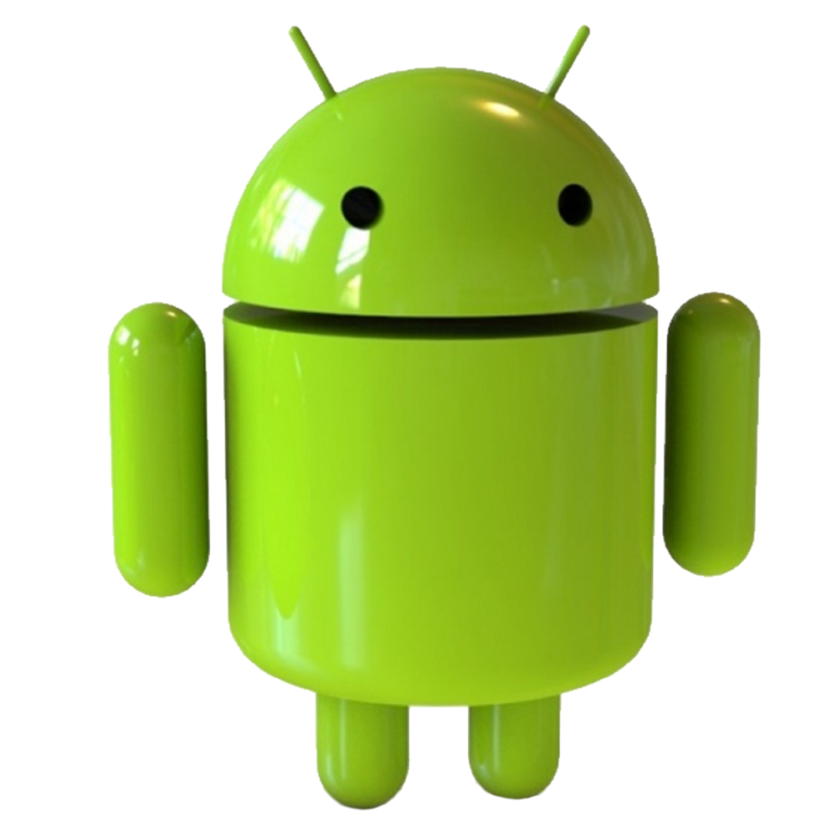
INTRODUCTION OF ANDROID:-
Android founded by Andy Rubin in 2003
Android is developed by Google.
Android is based on Linux Kernel.
Android is an open source platform.
It is developed to advancing open standards.
Android is managed by Java language.

Slide 4

INRTODUCTION OF IOS:-
IOS is developed by Apple.Inc.
IOS was unveiled in 2007.
IOS was developed by swift.
IOS was managed by C++ and Objective.
IOS was founded by Steve Jobs.
IOS is based on IOS kernel.

Slide 5
Features:-
Android
IOS
Highly customizable.
You can change almost
Everthing in UI.
Adding widgets.
Adding change launcher.
Adding customize effects.
Not customizable.
Can’t change the default
UI.
Can change wallpapers
and system sounds.

Slide 6
Features:-
Android
IOS
Based in linux kernel.
Open source.
Modify the code.
Create our own ROM.
Based on IOS kernel.
Not an open source.
Cant modify the code.
There is no ROM’s.

Slide 7
Features:-
Android
IOS
Easier than IOS
Using USB port and android file Transfer app.
Applications can be transferred through USB and android file app.
Less stability and less durability in software.
More difficult Android.
Media can be transferred using iTunes app.
Photos can be transferred through via USB.
More consistency and more durability in software.

Slide 8
Features:-
Android
IOS
It has large batteries with longer life.
Less secure in handling data.
Can be easily hackable.
Less data optimization.
It has smaller batteries with decent life.
More secure in handling data.
Can’t be hacked.
More data optimization.

Slide 9
Features:-
Android
IOS
Less accurate than IOS.
But more features than IOS.
More software updates.
More software problems.
More chance of entering malware.
More accurate than Android.
But less features than android.
Less software updates.
Less software problems.
Less chance of entering malware .

Slide 10
THANK YOU !

